Slide 1
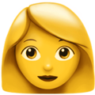
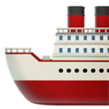
Peircian Cybersemiotics for Understanding Emoji Meaning-Making: Indexicality & Supervernaculars

Slide 2
– Where did I start with my PhD and why am I studying emoji semiotization rather than emoji meanings?
– A brief look at my first paper, resulting in;
– A theoretical embedding in a cybersemiotic framework with concepts that need to develop and be understood;
– Resulting in a new study (emojis as supervernaculars);
– A few examples of emoji semiotization from different perspectives;
– Two theoretical concepts emerge that need to be developed

Slide 3
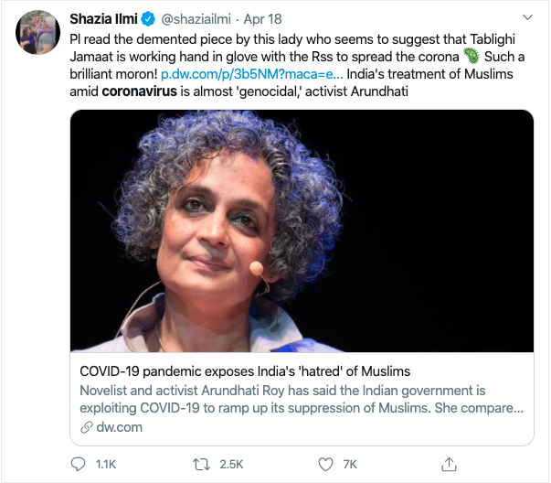
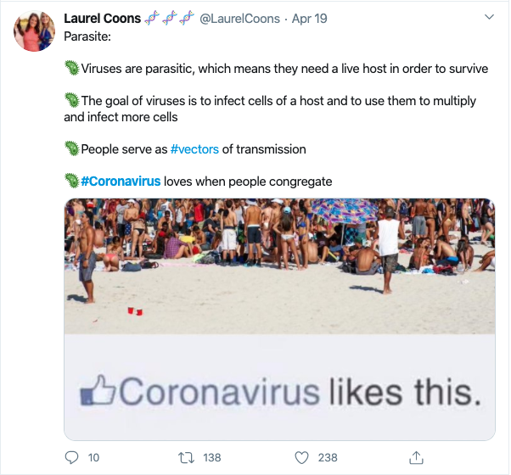
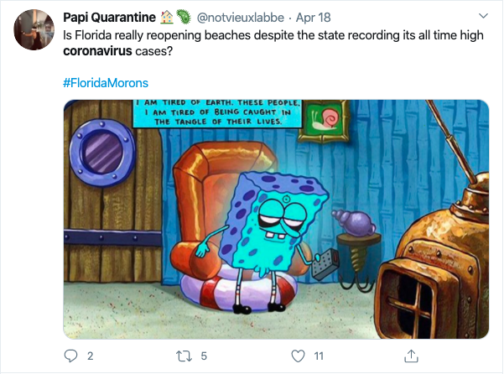
Emoji indexicals of the pandemic
SYMBOLIC
TYPOGRAPHICAL

Slide 4
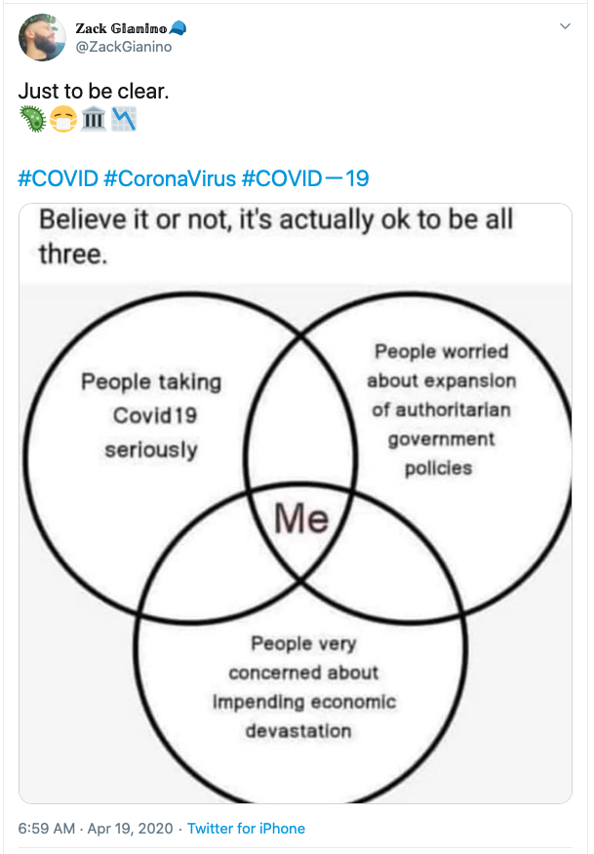
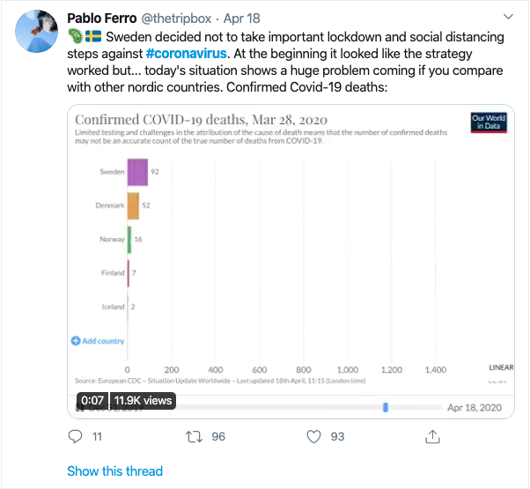
Emoji indexicals of the pandemic
INDEXICAL

Slide 5
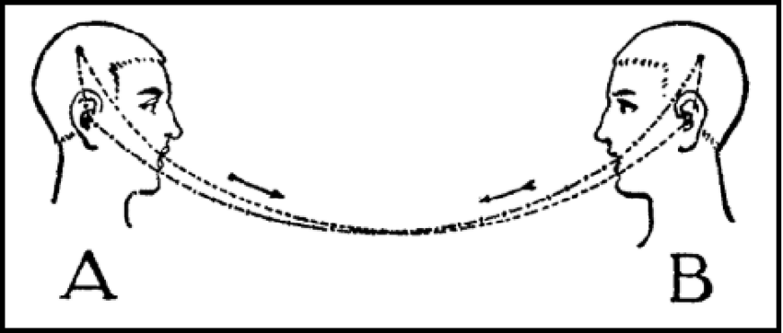
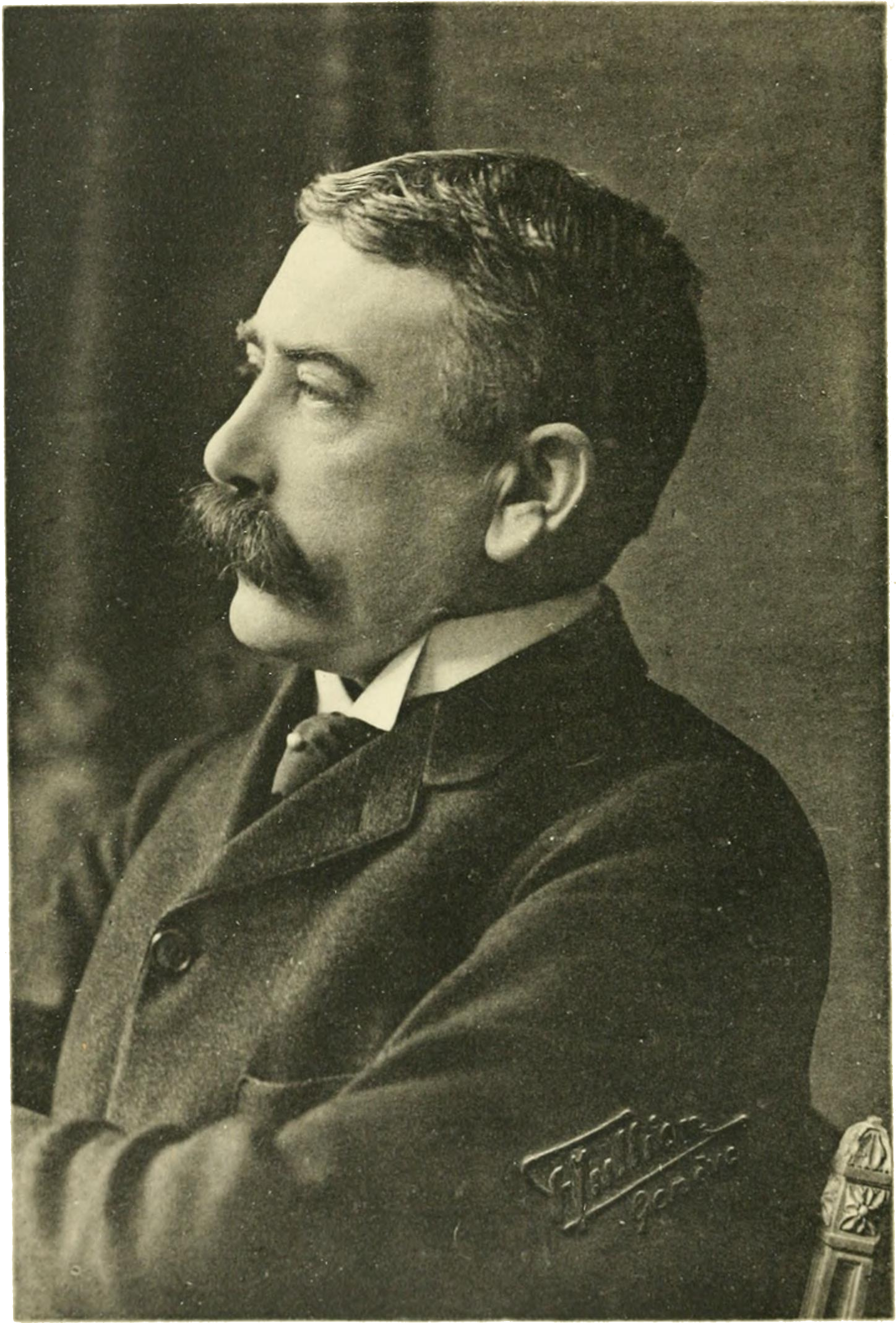
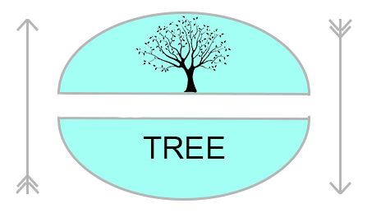
Ferdinand de Saussure (1857–1913)

Slide 6
Mikhail Mikhailovich Bakhtin (1895–1975)
CHRONOTOPE
CHRONOS = TIME
before 2020 & post 2020
TOPOS = PLACE
Alps vs. Palm Beach

Slide 7
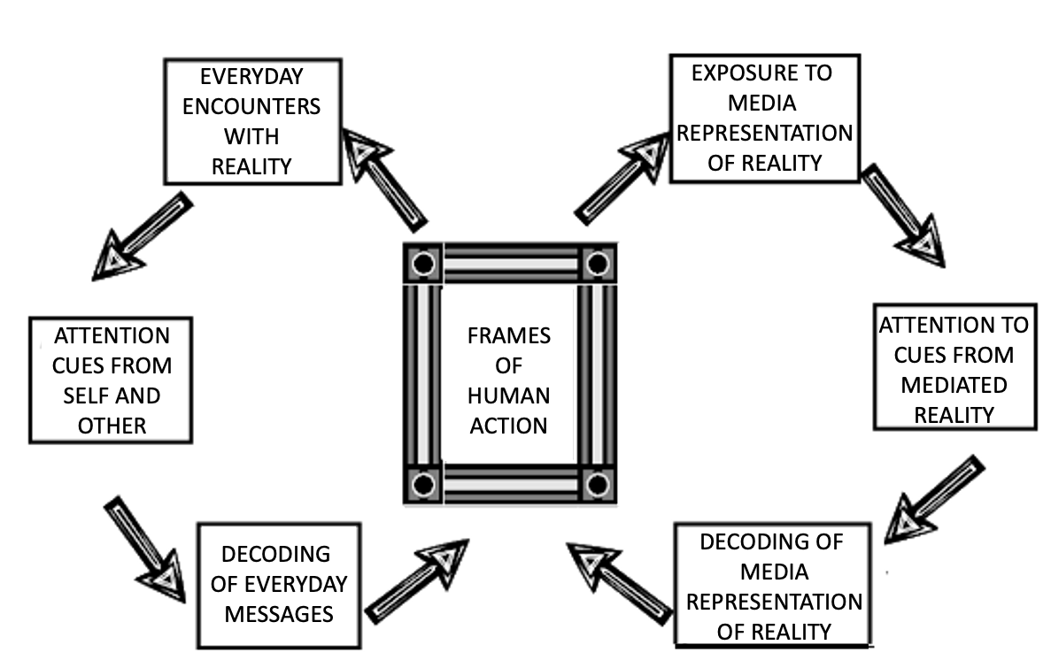
Erving Goffman (1922–1982)
FRAME

Slide 8
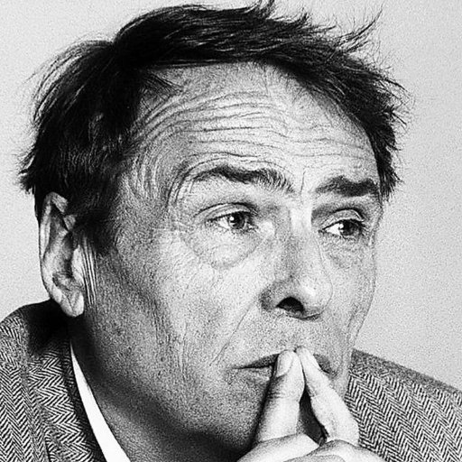
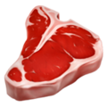
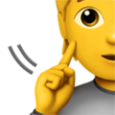
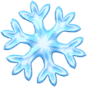
Pierre Bourdieu (1930–2002)
HABITUS
How people perceive the world around them and act towards it, based on their history and socio-cultural values

Slide 9
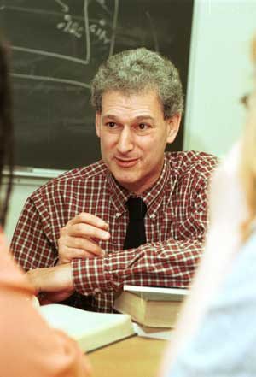
Theoretical embedding
LAYERS OF
Michael Silverstein (1945–2020)
INDEXICALITY
Referring or pointing to something
You/Sie/Vous/U/Usted/您
vs.
Thou/Du/Tu/Jij/Tú/你
SOCIO-CULTURAL
PHONOLOGIC
Labov’s ‘Fourth Floor’ experiment
TYPOGRAPHIC
vs.
LAYERS OF INDEXICALITY

Slide 10
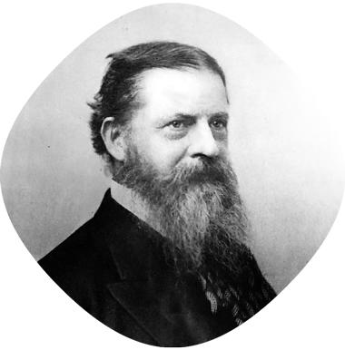
Charles S. Peirce (1839-1914)
Representamen (sign vehicle)
Qualisign
Sinsign
Legisign
Ground (reference type)
Iconic
Indexical
Symbolic
Interpretant (cognitive outcome)
ICONIC
INDEXICAL
SYMBOLIC
TREE

Slide 11
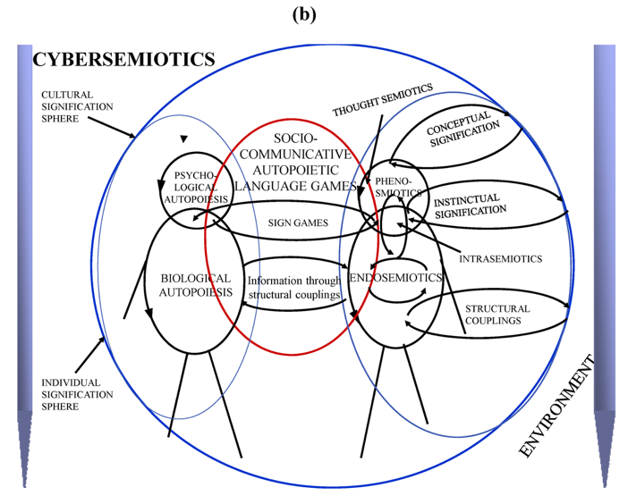
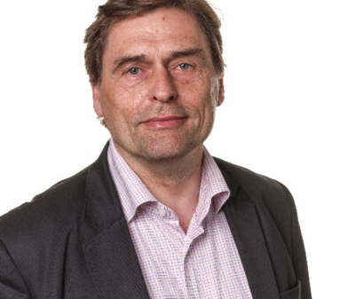
Theoretical embedding
Søren Brier (1951)

Slide 12
Cybersemiotics
Cyber – from κυβερνητική (kybernetiki, governance, steering)
Cybernetics (Mead, Weiner, Von Foerster) – study of control and communication in the animal and the machine, primarily interested in explaining purposiveness or goal-directed behavior
Blumer: “Organisms in interaction are observing each other’s ongoing activity, with each using portions of the developing action of the other as pivots for the redirection of his or her own action” (Blumer, 2004, p.18)
Cybersemiotics – knowledge is not neutral nor objective, it is interlaced with the process of knowledge production and the prior state of the knower.
a linguistic communicator is a biological agent (organism), (socio-) psychological (inter-)actant (individual), and a sociological actor (person).
Looking more closely at the relation between information and interpretation (understanding the Peircian ground)

Slide 13
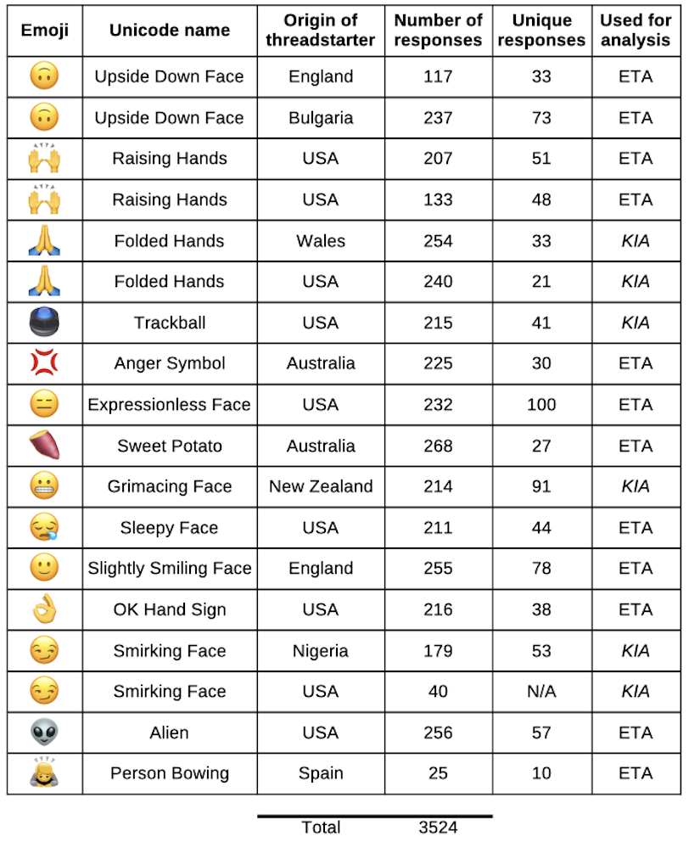
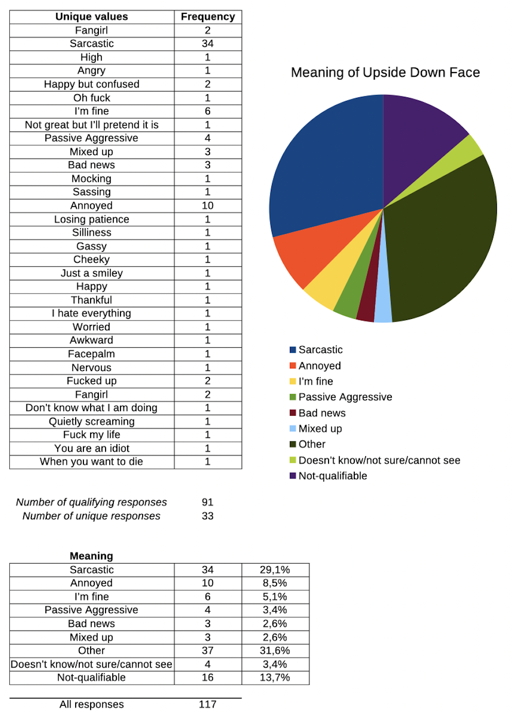
Emojis as Supervernaculars: Grassroots & Normative Approaches Towards Emoji Semiotization

Slide 14
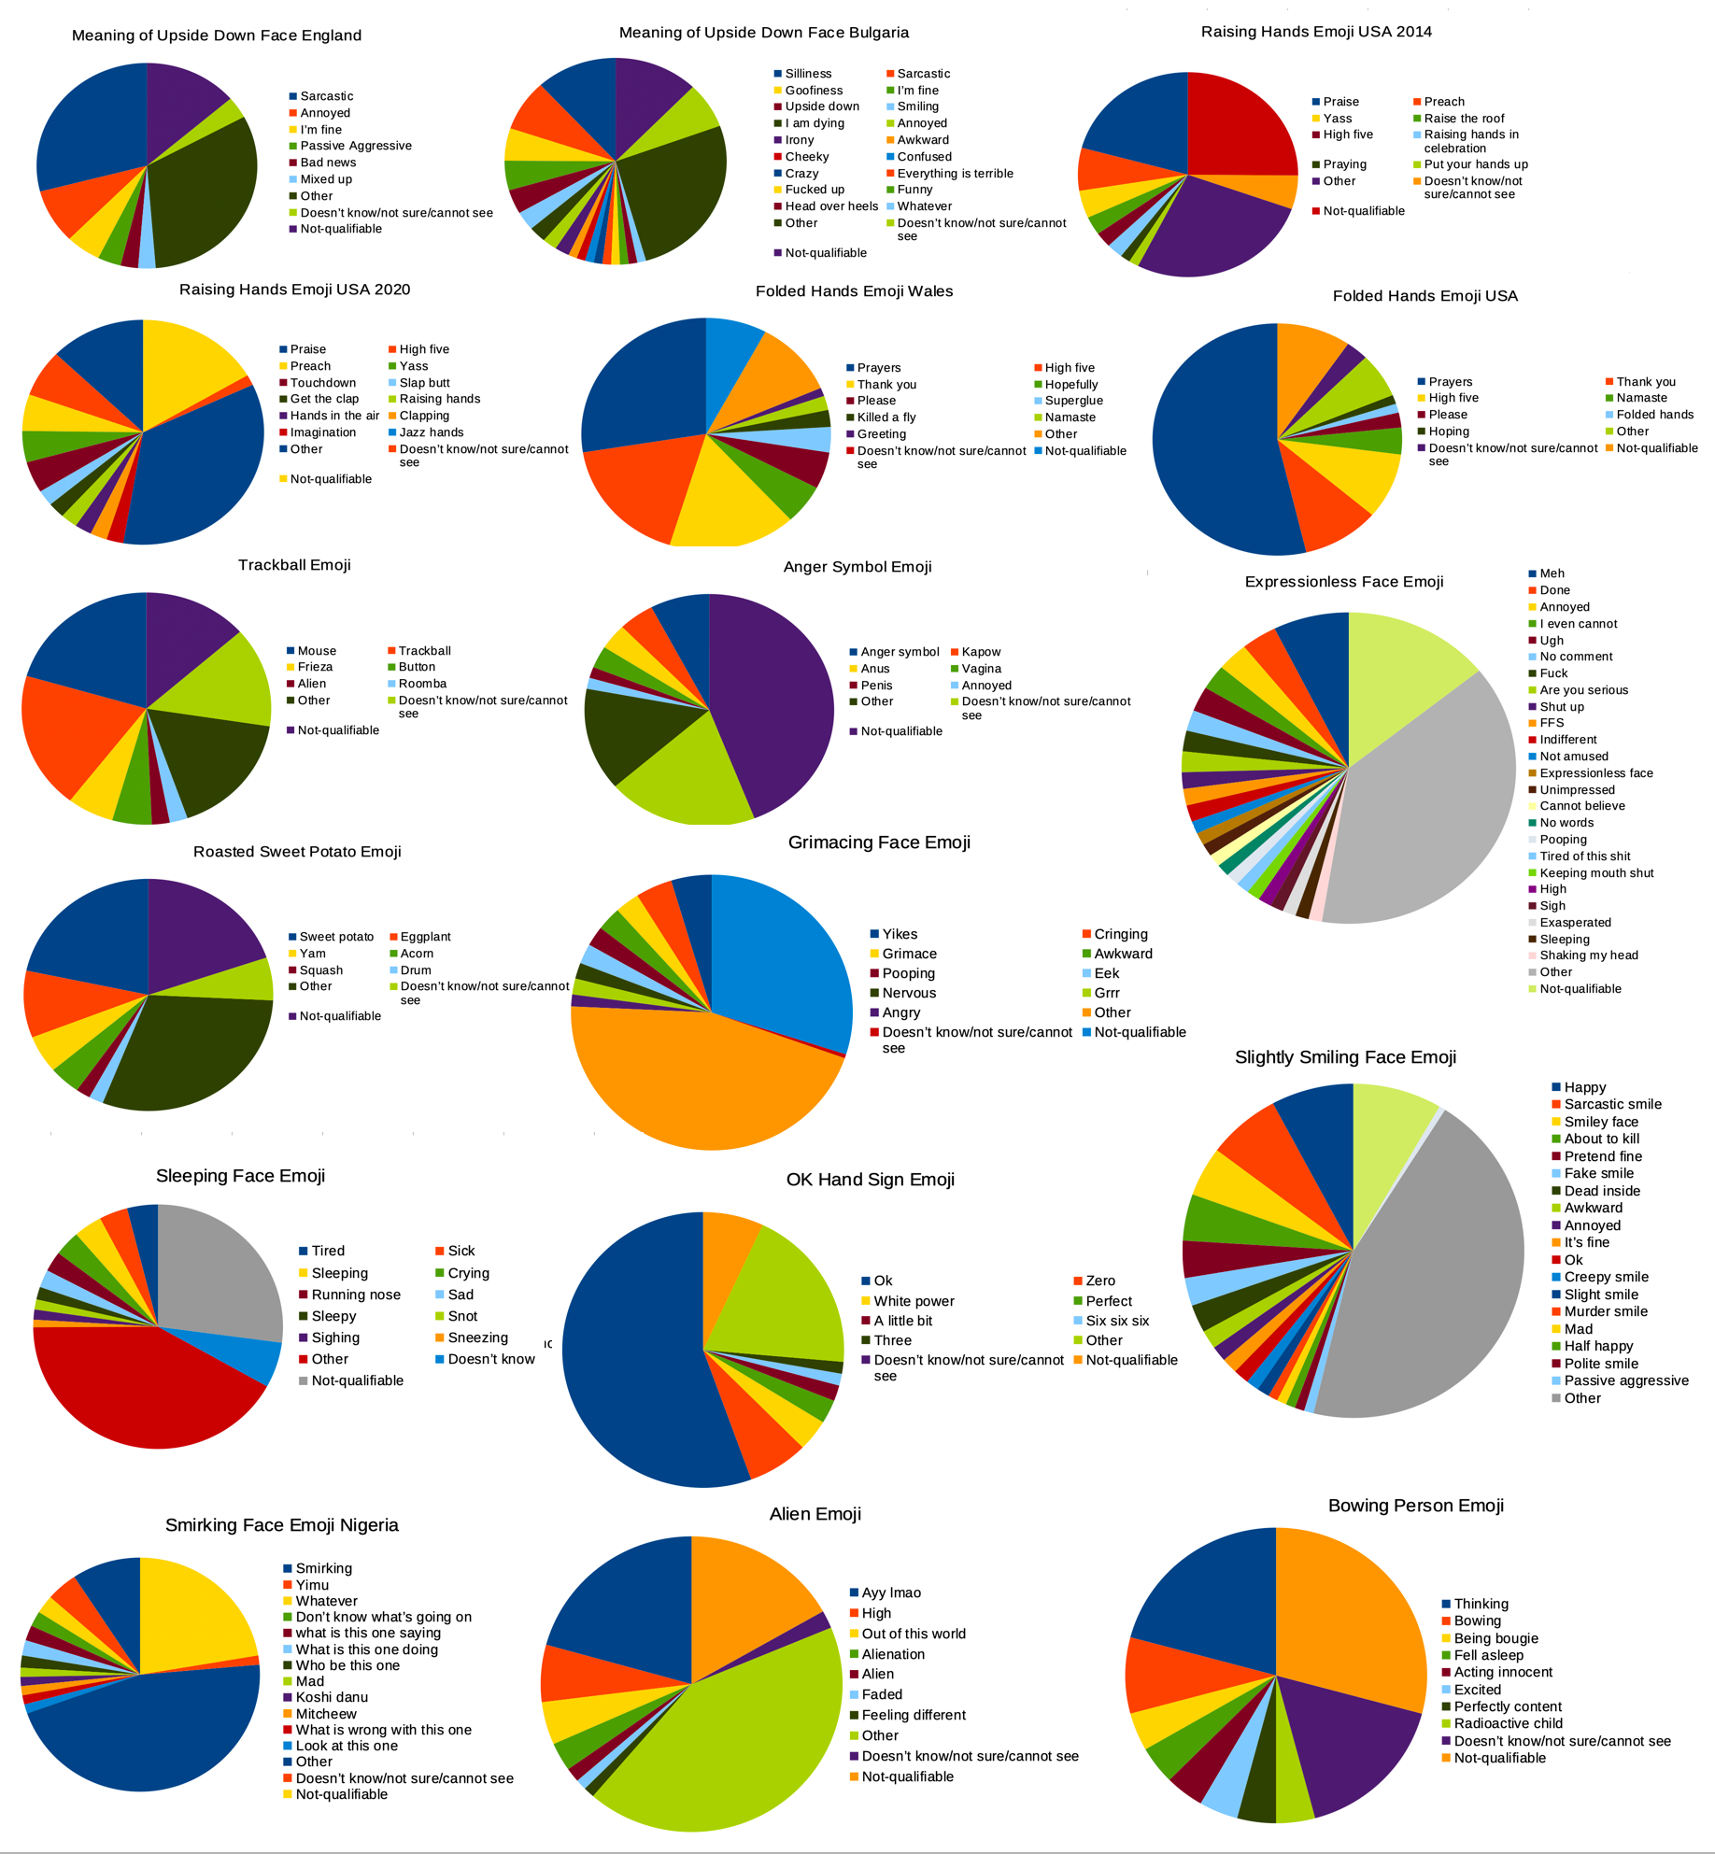
Emojis as Supervernaculars: Grassroots & Normative Approaches Towards Emoji Semiotization

Slide 15
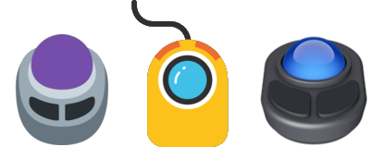
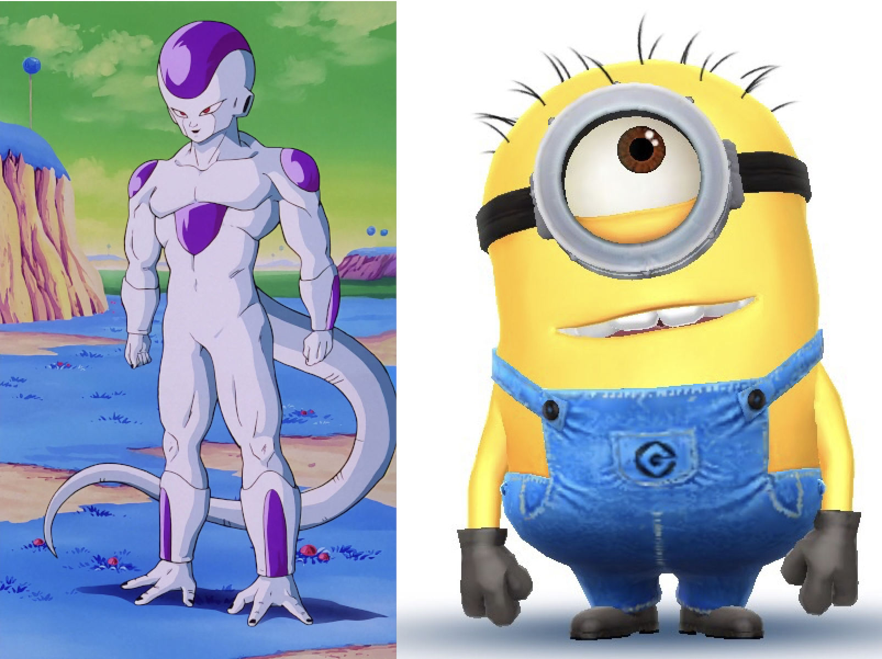
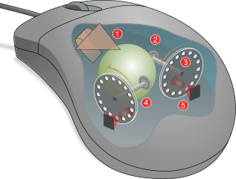
Trackball Emoji
Emojis as Supervernaculars: Grassroots & Normative Approaches Towards Emoji Semiotization

Slide 16
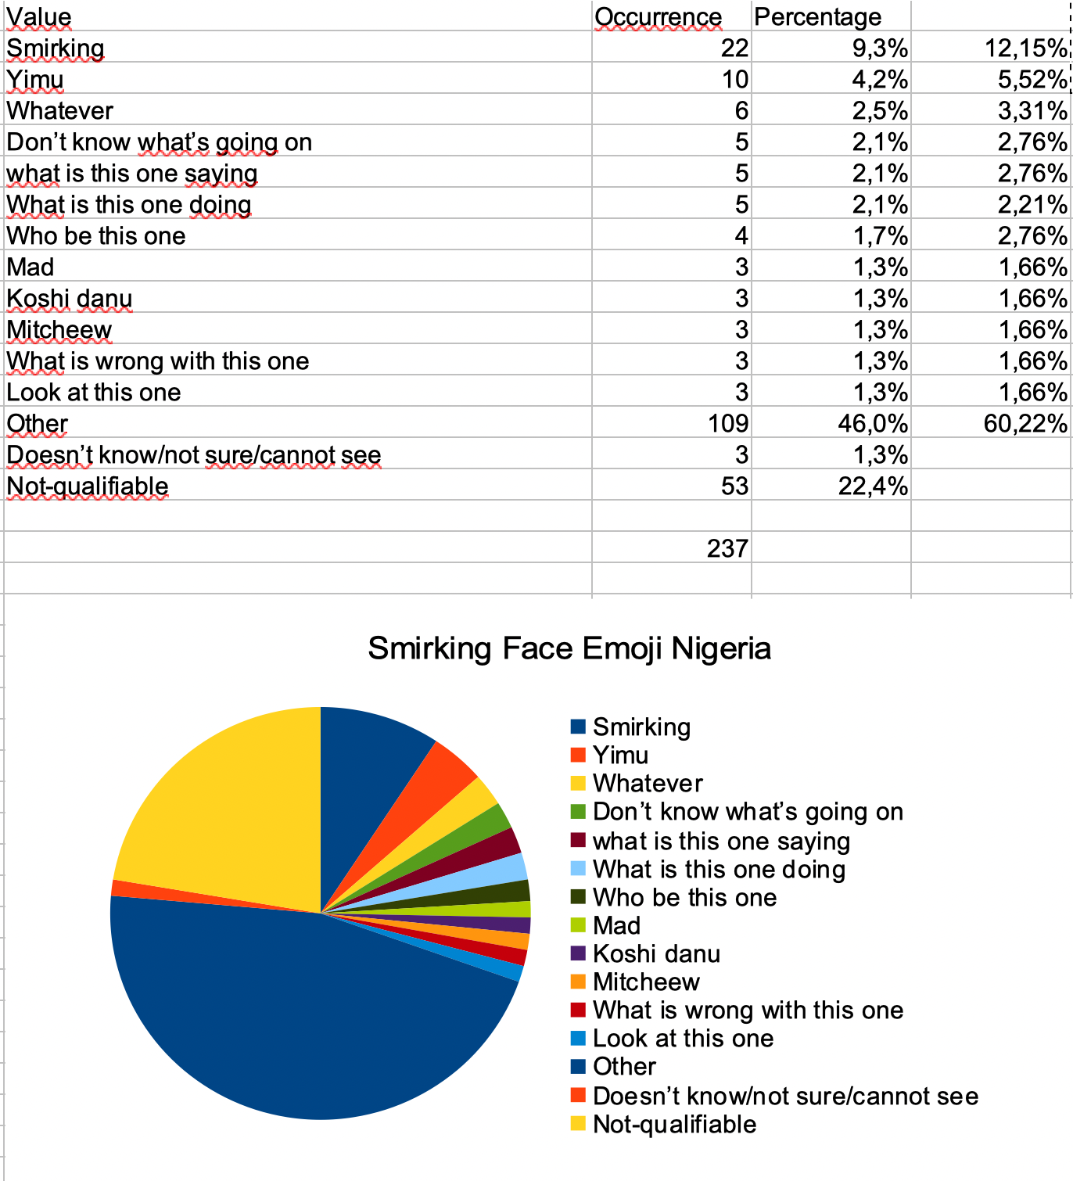
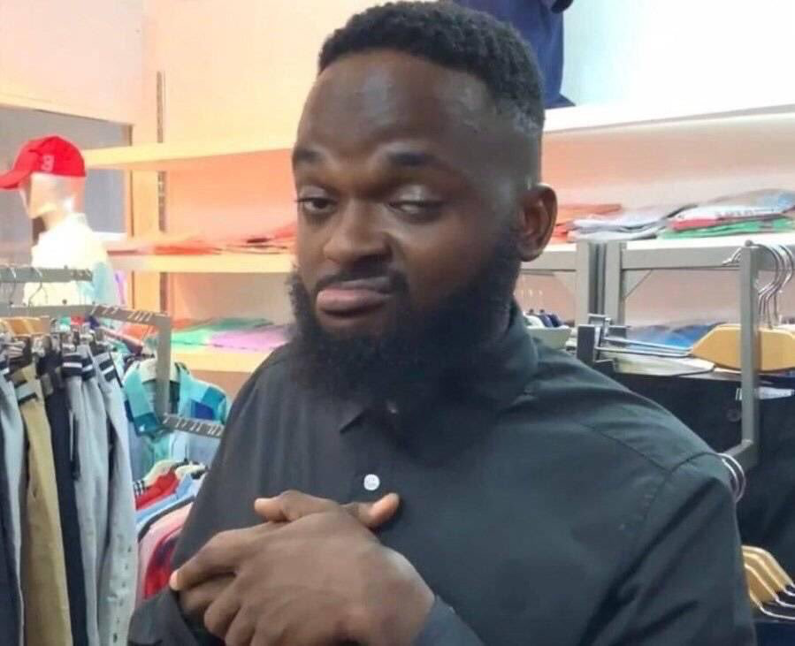
Emojis as Supervernaculars: Grassroots & Normative Approaches Towards Emoji Semiotization
Smirking Face Emoji
Comparison to US discussion
(account removed, we’re looking at an internet ruin)

Slide 17
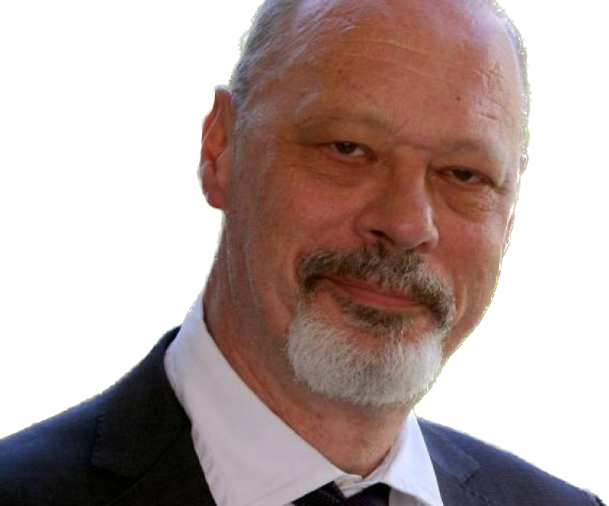
Emojis as Supervernaculars: Grassroots & Normative Approaches Towards Emoji Semiotization
Jan Blommaert (1961–2021)
Supervernaculars
– Widespread codes used by communities that do not correspond to ‘traditional’ sociolinguistic speech communities
– Going through en-globalization and de-globalization
– Dynamic, mobile, unstable, yet ordered processes, messy, unpredictable but understandable at a deeper level
– A dynamic complex of emerging, stabilizing and changing dialects we actually observe, hear, speak, read and write (the intention we put into it)
Grassroots literacies (to ‘Grassroots semiotization)
– Literacies that do not correspond with ‘normalcy’ (i.e., normative literacies)
– See for example TextSpeak (between South-African teenagers) – But rather than a literacy, see it as a way of semiotization, a bottom-up approach of meaning-making. It’s not wrong per se, it’s the way that ‘they put intention into it’

Slide 18
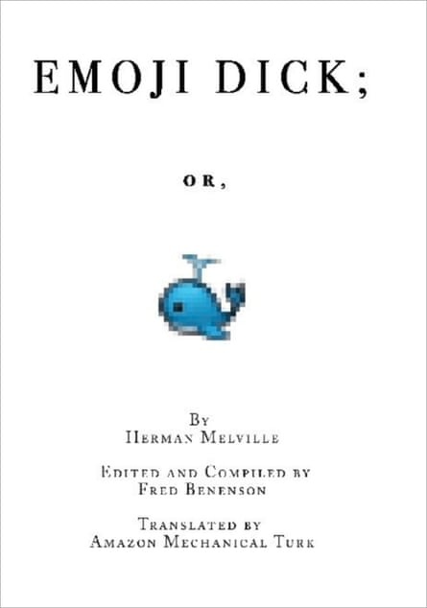
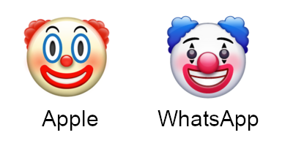
FEATURES OF EMOJI: SYMBOLIC
Translations are hard to read
Some lines can be found multiple times
Emojis are updated, might become unreadable
Differences between platforms

Slide 19
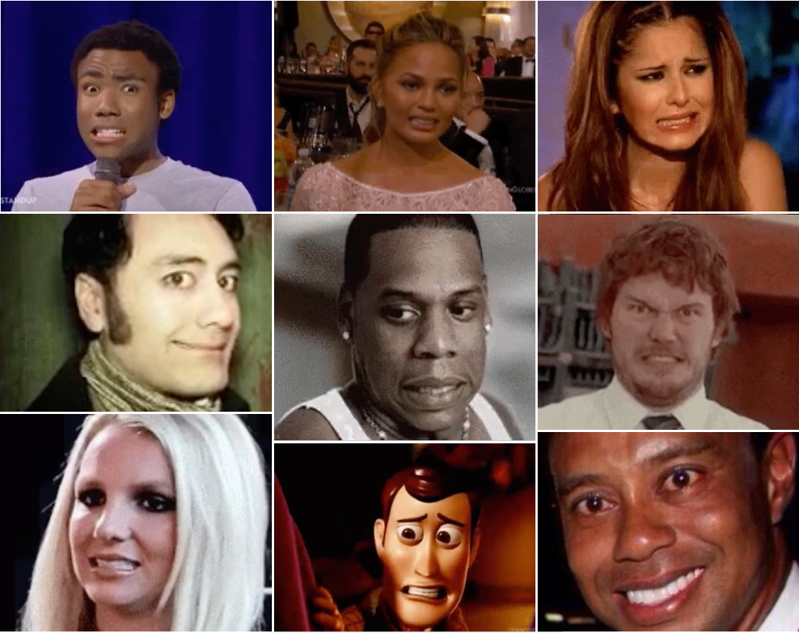
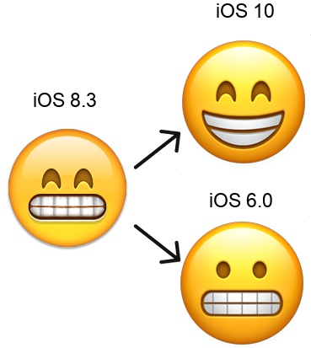
Grimacing Face Emoji

